Slide 1
MOUNT KENYA UNIVERSITY SCHOOL OF CUMPUTING AND INFORMATICS MASTERS IN IFORMATION TECHNOLOGY
GROUP 4
JOAN LUMUKWANA
DIDA KANCHORA

Slide 2
MODULE 6.0Exploiting Application-Based Vulnerabilities
Overview of Web Application-Based Attacks for Security Professionals and the OWASP Top 10.
Web applications use many different protocols, the most prevalent of which is HTTP.
This course assumes that you have a basic understanding of Internet protocols and their use, but this module takes a deep dive into the components of protocols like HTTP that you will find in nearly all web applications.
The HTTP Protocol
The HTTP 1.1 protocol is defined in RFCs 7230-7235.
In the examples in this module, when we refer to an HTTP server , we mean a web server.
When we refer to HTTP clients, we are talking about browsers, proxies, API clients, and other custom HTTP client programs.
HTTP is a very simple protocol, which is both a good thing and a bad thing.
In most cases, HTTP is categorized as a stateless protocol that does not rely on a persistent connection for communication logic.
An HTTP transaction consists of a single request from a client to a server, followed by a single response from the server back to the client.
HTTP is different from stateful protocols, such as FTP, SMTP, IMAP, and POP. When a protocol is stateful, sequences of related commands are treated as a single interaction.
A server must maintain the state of its interaction with the client throughout the transmission of successive commands until the interaction is terminated.
A sequence of transmitted and executed commands is often called a session.

Slide 3
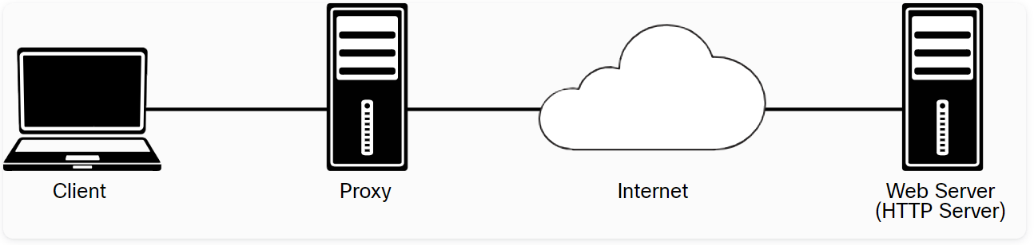
HTTP proxies act as both servers and clients. Proxies make requests to web servers on behalf of other clients. They enable HTTP transfers across firewalls and can also provide support for caching of HTTP messages. Proxies can perform other roles in complex environments, including Network Address Translation (NAT) and filtering of HTTP requests.

Slide 4
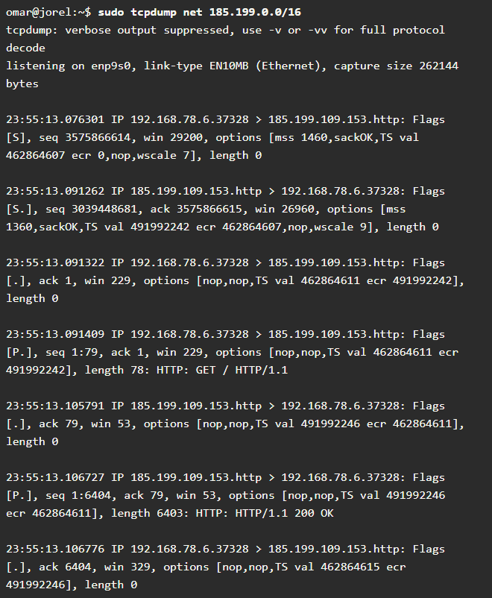
Example 6-1 - Packet Capture of an HTTP Request and Response Using tcpdump
Example 6-1 - Packet Capture of an HTTP Request and Response Using tcpdump

Slide 5
Understanding Injection- Based vulnerabilities
SQL Injection Vulnerabilities
SQL injection (SQLi) vulnerabilities can be catastrophic because they can allow an attacker to view, insert, delete, or modify records in a database. In injection attack, the attacker inserts, or injects, partial or complete SQL queries via the web application. The attacker injects SQL commands into input fields in an application or a URL in order to execute predefined SQL commands.
Some of the SQL commands
SELECT: Used to obtain data from a database
UPDATE: Used to update data in a database
DELETE: Used to delete data from a database
INSERT INTO: Used to insert new data into a database
CREATE DATABASE: Used to create a new database
ALTER DATABASE: Used to modify a database
CREATE TABLE: Used to create a new table
ALTER TABLE: Used to modify a table
DROP TABLE: Used to delete a table
CREATE INDEX: Used to create an index or a search key element
DROP INDEX: Used to delete an index

Slide 6
Techniques that can be used to exploit SQL injection vulnerabilities:
Union operator: This is typically used when an SQL injection vulnerability allows a SELECT statement to combine two queries into a single result or a set of results.
Boolean: This is used to verify whether certain conditions are true or false.
Error-based technique: This is used to force the database to generate an error in order to enhance and refine an attack (injection).
Out-of-band technique: This is typically used to obtain records from the database by using a different channel. For example, it is possible to make an HTTP connection to send the results to a different web server or a local machine running a web service.
Time delay: It is possible to use database commands to delay answers. An attacker may use this technique when he or she doesn’t get output or error messages from the application.

Slide 7
Overview of Web Application-Based Attacks for Security Professionals and the OWASP Top 10
A web session is a sequence of HTTP request and response transactions between a web client and a server.
These transactions include pre-authentication tasks, the authentication process, session management, access control, and session finalization.Numerous web applications keep track of information about each user for the duration of a web transaction.Several web applications have the ability to establish variables such as access rights and localization settings.
These variables apply to each and every interaction a user has with the web application for the duration of the session.Web applications can create sessions to keep track of anonymous users after the very first user request.
For example, an application can remember the user language preference every time it visits thesite or application front end.
In addition, a web application uses a session after the user has authenticated.This allows the application to identify the user on any subsequent requests and be able to apply security access controls and increase the usability of the application. In short, web applications can provide session capabilities both before and after authentication.

Slide 8
Exploiting Authentication-Based Vulnerabilities Session Hijacking
There are several ways an attacker can perform session hijacking and several ways a session token may be compromised:
Predicting session tokens: This is why it is important to use non-predictable tokens, as previously discussed in this section.
Session sniffing: This can occur through collecting packets of unencrypted web sessions.
On-path attack (formerly known as man-in-the-middle attack): With this type of attack, the attacker sits in the path between the client and the web server. In addition, a browser (or an extension or a plugin) can be compromised and used to intercept and manipulate web sessions between the user and the web server.
This browser-based attack was previously known as a man-in-the-browser attack.If web applications do not validate and filter out invalid session ID values, they can potentially be used to exploit other web vulnerabilities, such as SQL injection (if the session IDs are stored on a relational database) or persistent XSS (if the session IDs are stored and reflected back afterward by the web application).

Slide 9
THE END

